Slide 1
Bootstrap Your Own Latent A New Approach to Self-Supervised Learning
BYOL

Slide 2
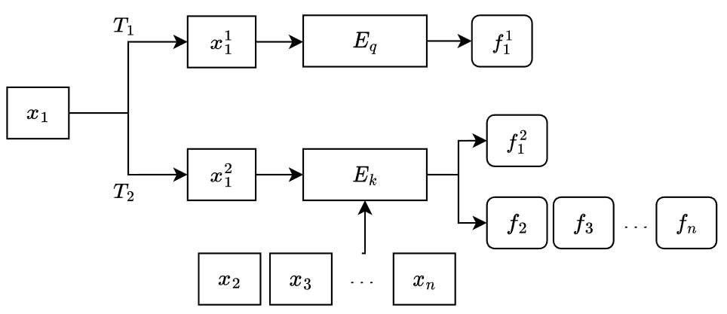

Review MoCo
Positive Sample 正樣本
Negative Sample 負樣本
n 張圖片

Slide 3
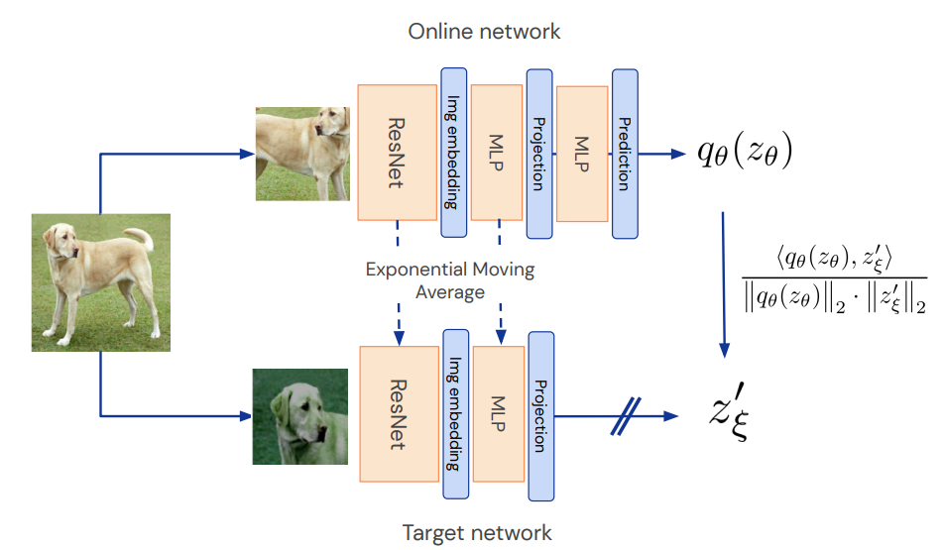
What BYOL do
MSE loss

Slide 4
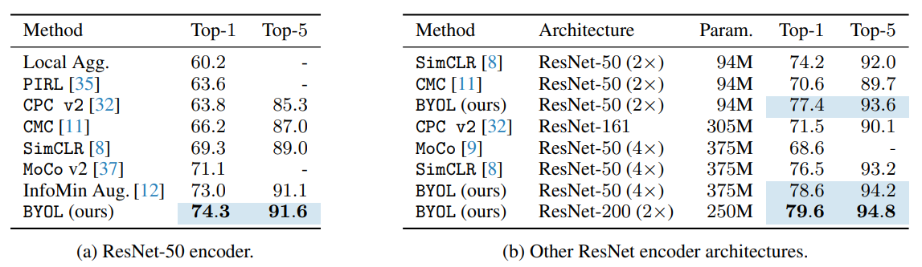
Linear evaluation on ImageNet
Freeze encoder after pre-training on ImageNet ILSVRC-2012 dataset
Train another classifier

Slide 5
